Slide 1
Mechanism of disease:
The role of the epithelial cytokines in asthma
Images repository
Please cite AstraZeneca 2022

Slide 2

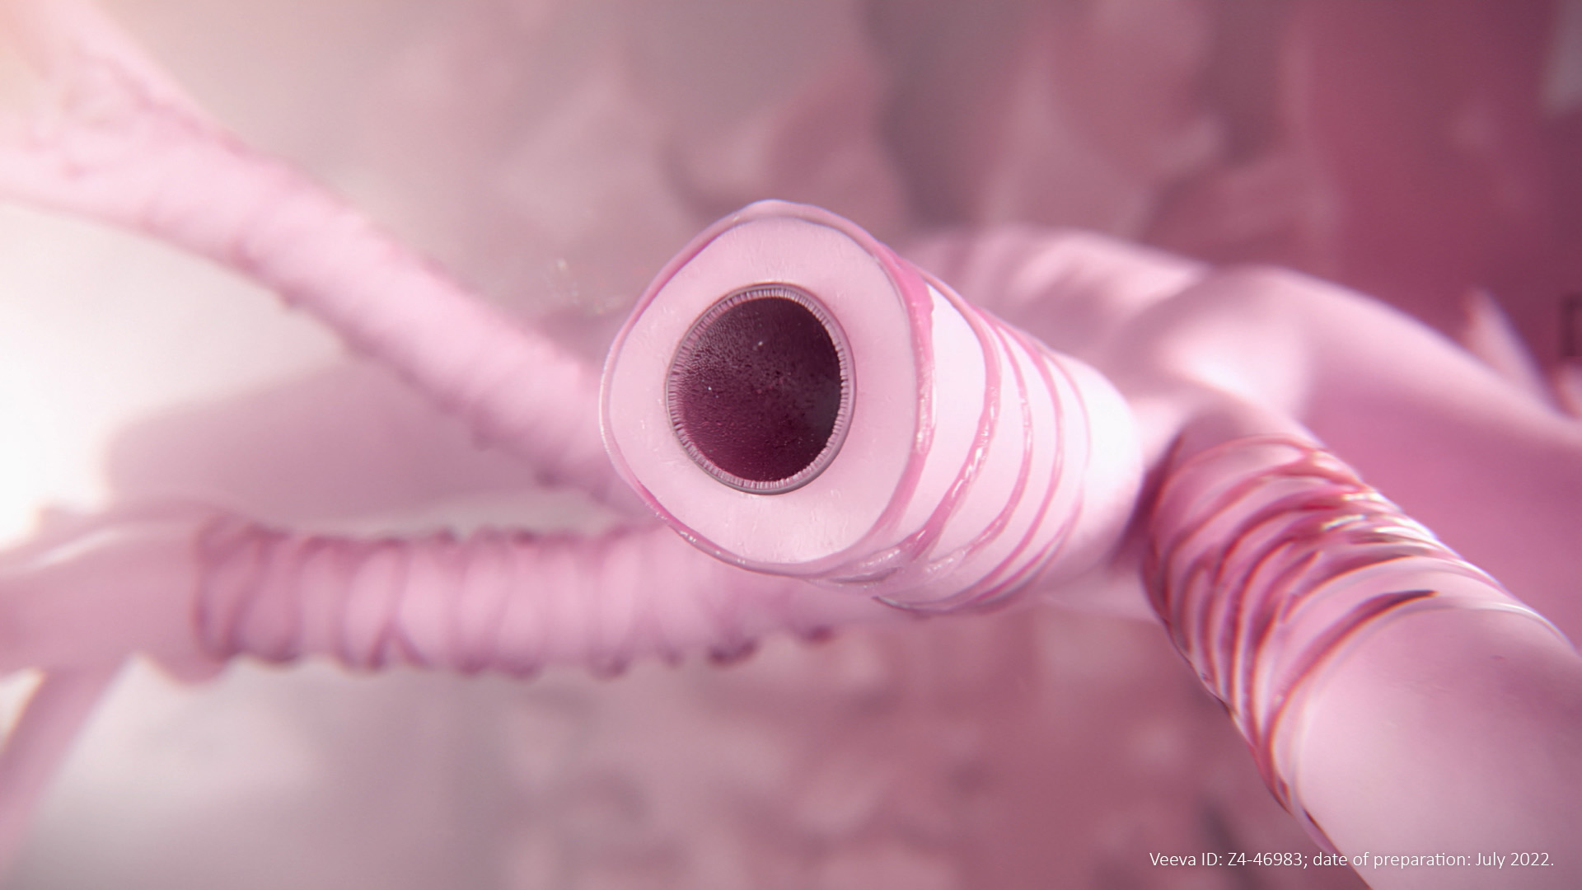
The airways are exposed to environmental insults
The airways are constantly exposed to insults such as inhaled pathogens, pollutants and aeroallergens^{1,2}
1. Tam A, et al. Ther Adv Respir Dis. 2011;5:255–273; 2. Heijink IH, et al. Allergy. 2020;75:1902–1917

Slide 3
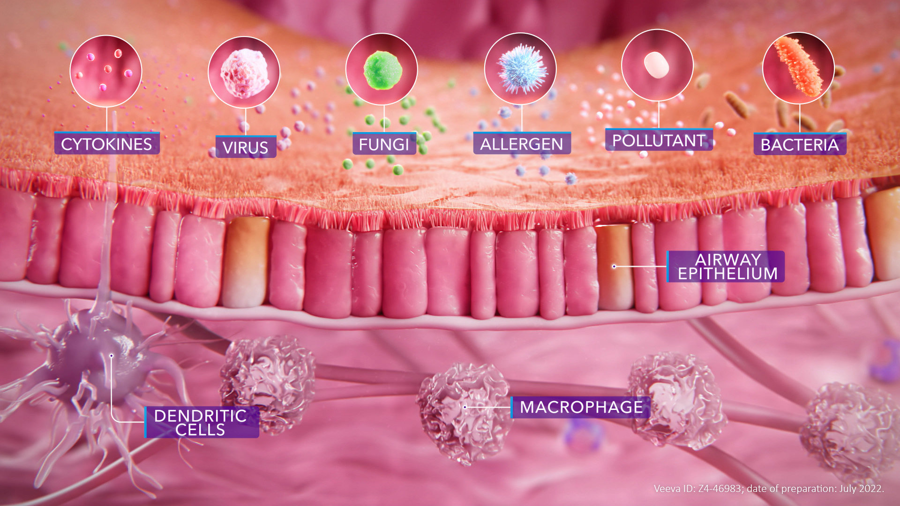
The airway epithelium acts as a physical and immunological barrier
The airway epithelium is the first line of defence against insults such as allergens, pathogens and pollutants.^{1,2} It provides an effective physical barrier comprising epithelial cells held together by cell-cell junctions, rendering the structure impermeable, and an immunological barrier that recognises and
controls pathogens^{3,4}
1. Tam A, et al. Ther Adv Respir Dis. 2011;5:255–273; 2. Heijink IH, et al. Allergy. 2020;75:1902–1917; 3. Vareille M, et al. Clin Microbiol Rev. 2011;24:210–229;
4. Bartemes KR, Kita H. Clin Immunol. 2012;143:222–235

Slide 4
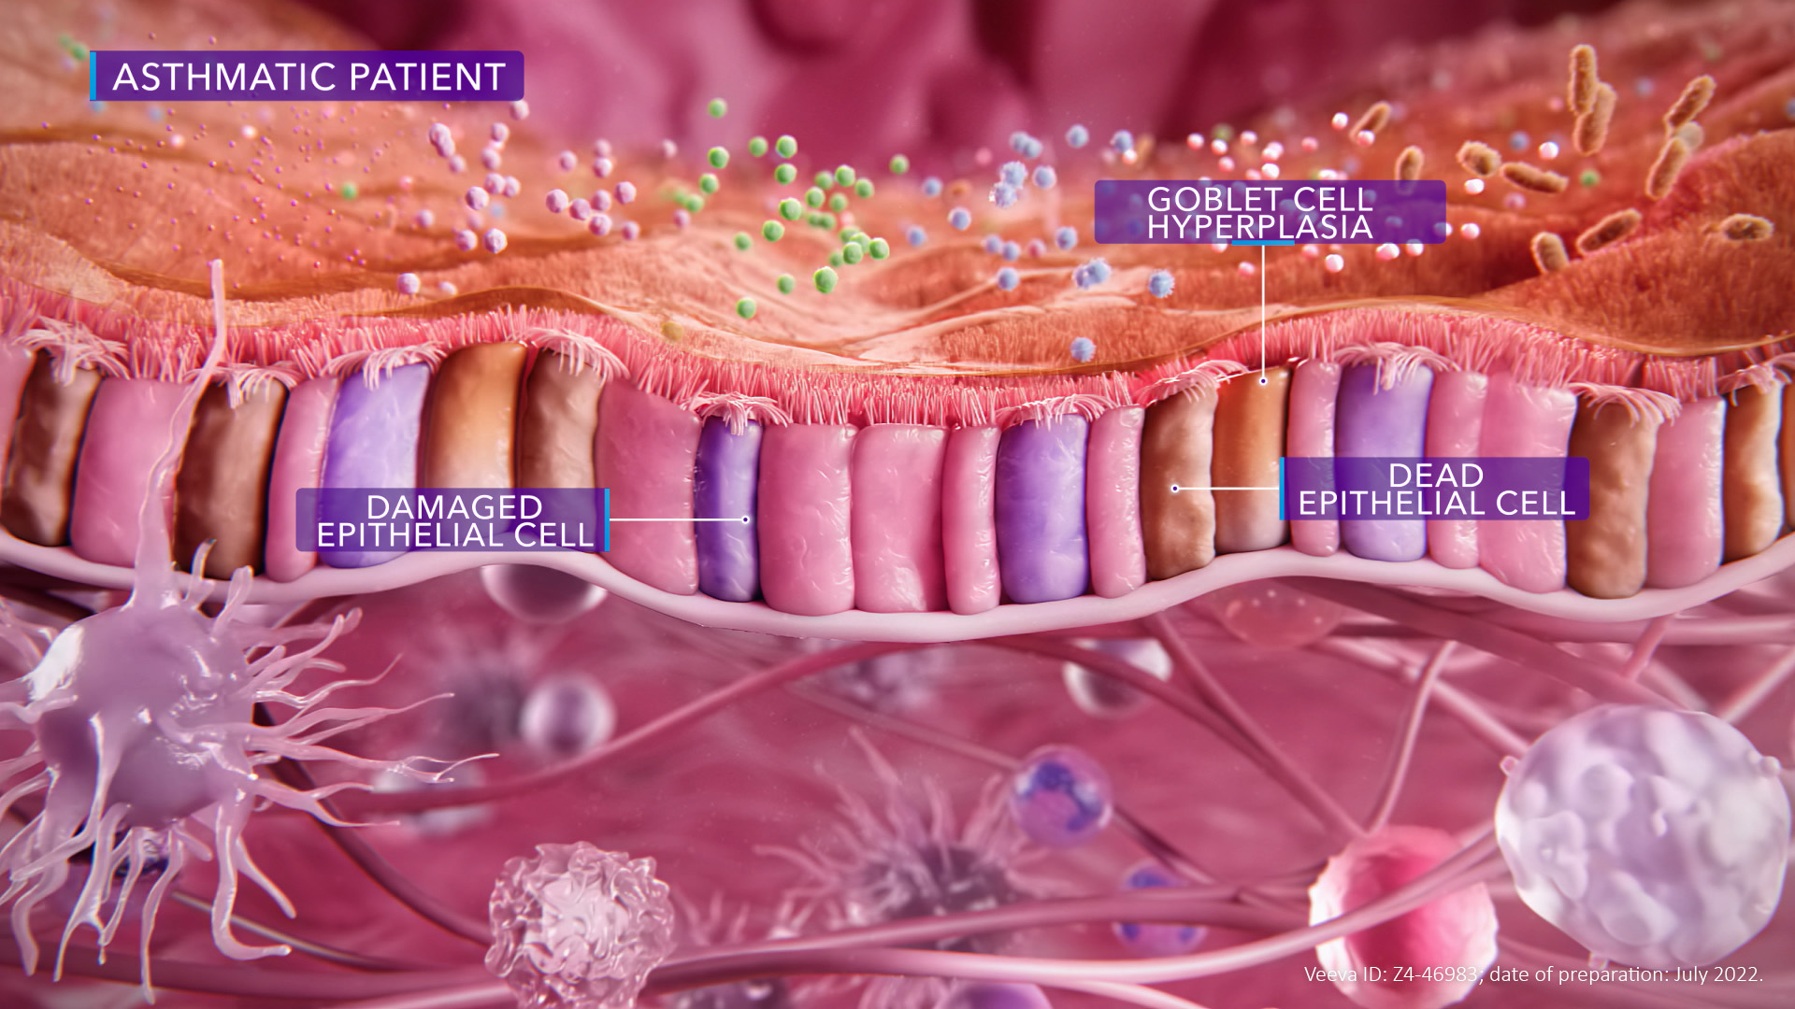
Epithelial damage leads to physiological changes to the airways
In patients with asthma, the epithelial barrier is damaged: cell structure is compromised and there are gaps between cells.^{1,2} These disruptions leave the cells vulnerable to environmental insults.^{1,2} The resulting inflammation and structural changes can cause reversible airway obstruction and contribute to airway hyperresponsiveness^{3,4}
1. Bartemes KR, Kita H. Clin Immunol. 2012;143:222–235; 2. Heijink IH, et al. Allergy. 2020;75:1902–1917; 3. Ward C, et al. Thorax. 2002;57:309–316; 4. Berend N, et al. Respirology. 2008;13:624−631

Slide 5
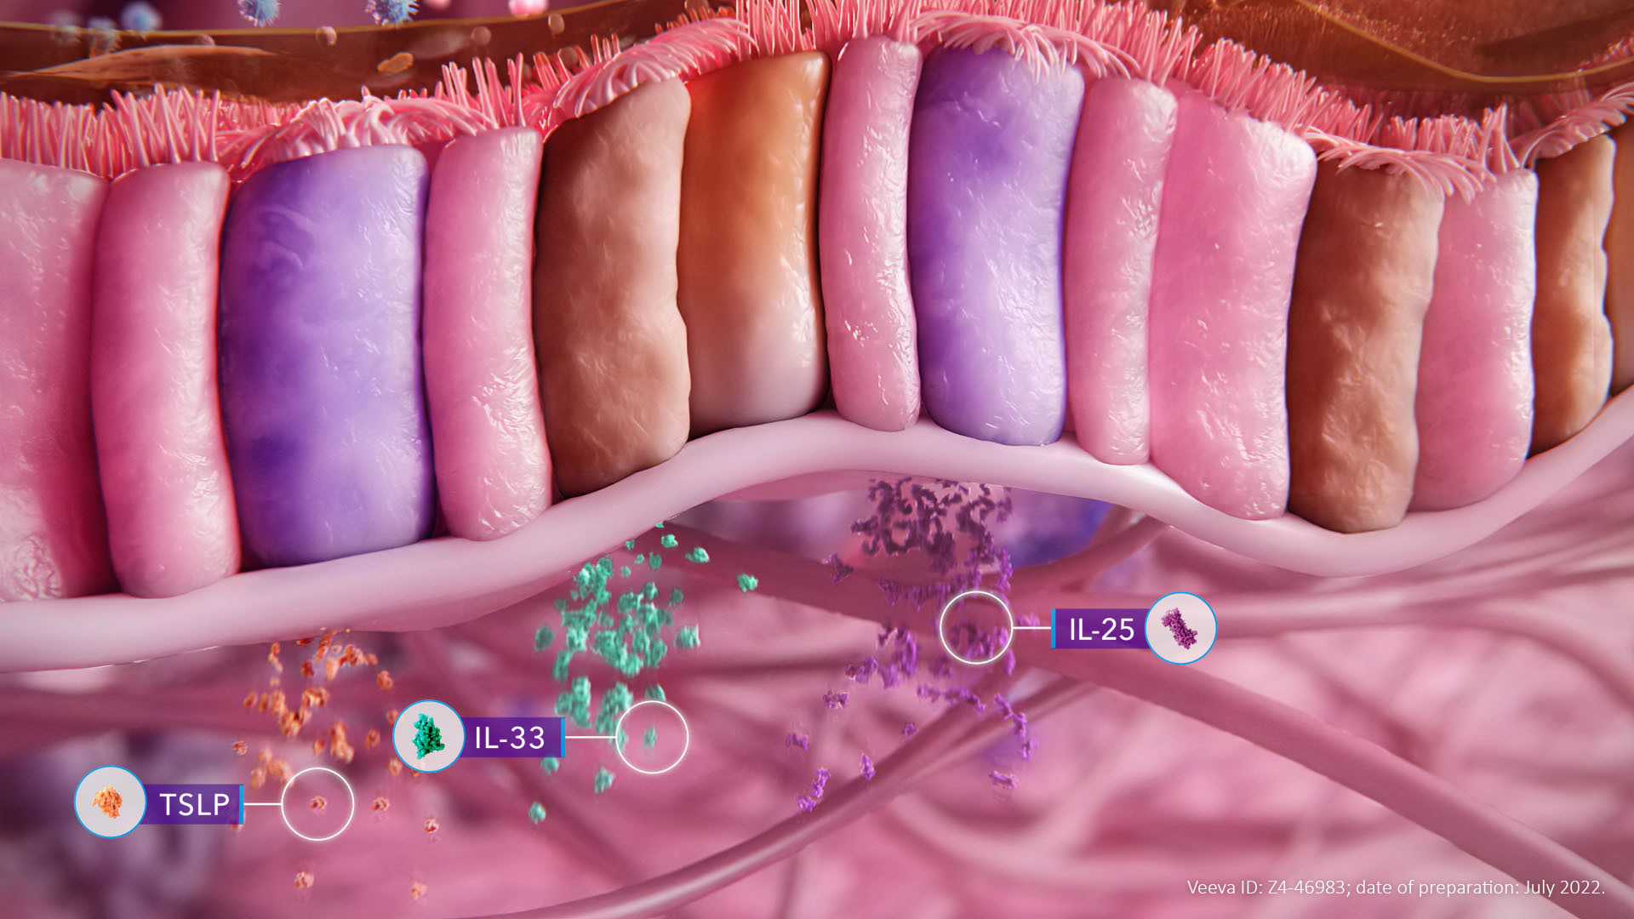
Epithelial damage results in the release of alarmins
Environmental insults and the subsequent epithelial damage trigger the release of epithelial cytokines, or alarmins, including IL-33, TSLP and IL-25
IL, interleukin; TSLP, thymic stromal lymphopoietin
Roan F, et al. J Clin Invest. 2019;129:1441–1451

Slide 6
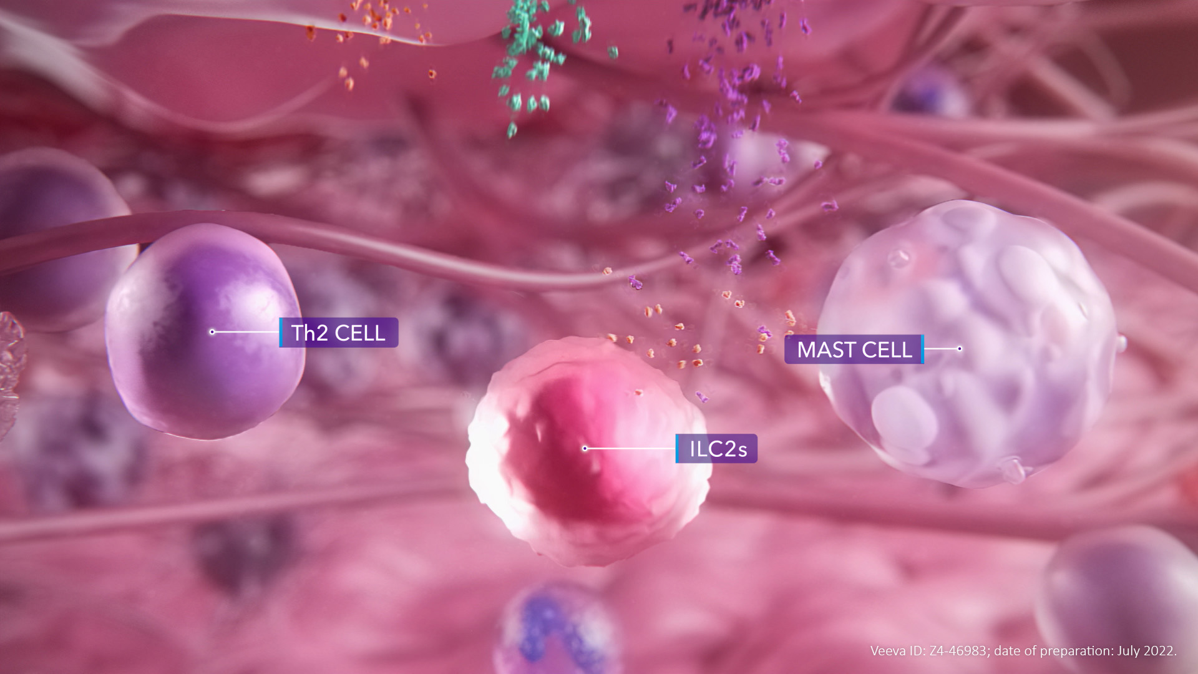
Alarmins drive airway inflammation
Alarmins such as IL-33, TSLP and IL-25 drive innate and adaptive inflammatory responses and act across the spectrum of asthma inflammation in overlapping but distinct ways. Their targets include
Th2 cells, ILC2s and mast cells
IL, interleukin; ILC2, type 2 innate lymphoid cell; Th, T helper; TSLP, thymic stromal lymphopoietin
Roan F, et al. J Clin Invest. 2019;129:1441–1451

Slide 7
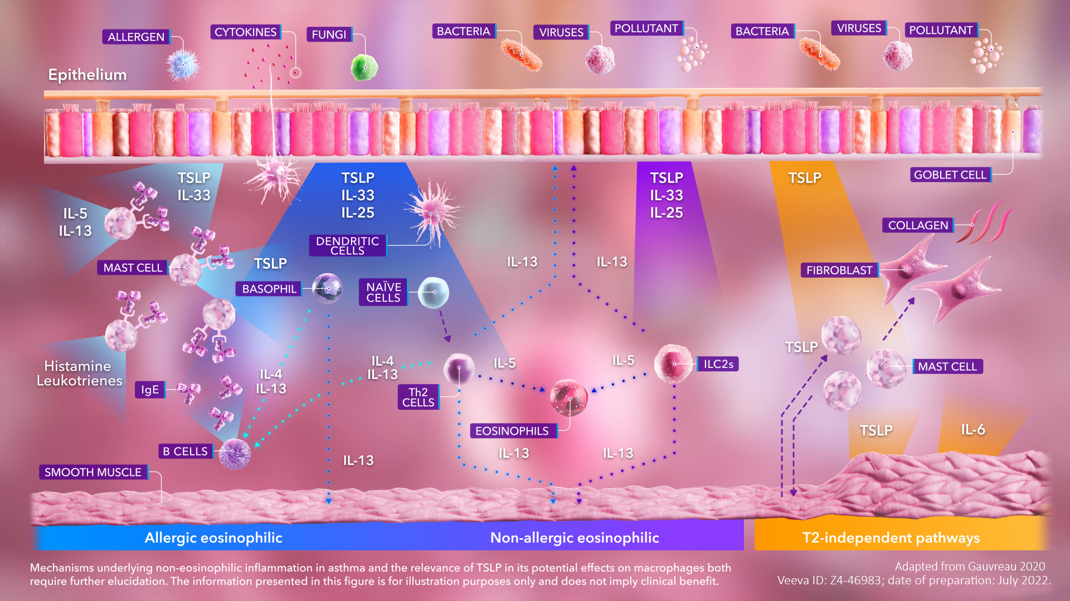
Alarmins drive inflammation from the top of the cascade
IL-33, TSLP and IL-25 can all drive allergic and non-allergic eosinophilic inflammation via effects on dendritic cells, basophils, mast cells and ILC2s.^{1,2} Beyond T2 inflammation, TSLP can regulate the interaction between mast cells and airway smooth muscle cells.^{3,4} TSLP has also been reported to stimulate the synthesis of collagen by lung fibroblasts, promoting airway remodelling.⁴ Ultimately, these
T2-independent effects can contribute to airway hyperresponsiveness^{4,5}
IgE, immunoglobulin E; IL, interleukin; ILC2, type 2 innate lymphoid cell; T2, type 2; Th, T helper; TSLP, thymic stromal lymphopoietin
1. Menzies-Gow A, et al. Respir Res. 2020;21:268; 2. Roan F, et al. J Clin Invest. 2019;129:1441–1451; 3. Kaur D, et al. Chest. 2012;142:76–85;
4. Gauvreau GM, et al. Expert Opin Ther Targets. 2020;24:777–792; 5. Ishmael FT. J Am Osteopath Assoc. 2011;111:S11–S17

Slide 8
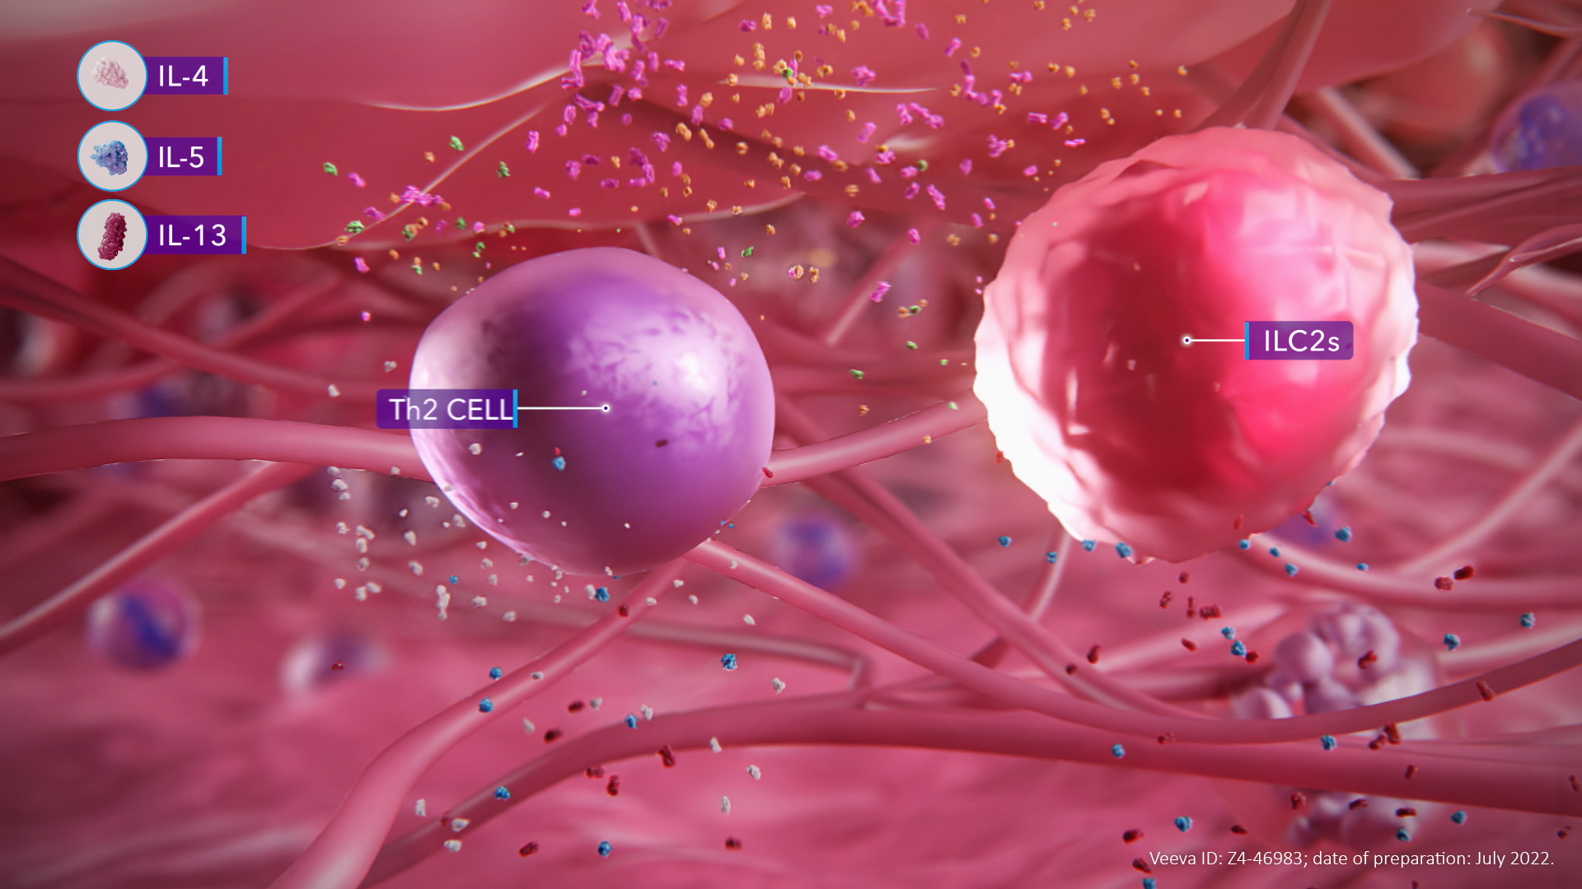
Th2 cells and ILC2s act downstream of the epithelial cytokines
In response to stimulation by epithelial cytokines TSLP, IL-33 and IL-25, Th2 cells and ILC2s release downstream cytokines including IL-4, IL-5 and IL-13^{1–3}
IL, interleukin; ILC2, type 2 innate lymphoid cell; Th, T helper; TSLP, thymic stromal lymphopoietin
1. Menzies-Gow A, et al. Respir Res. 2020;21:268; 2. Roan F, et al. J Clin Invest. 2019;129:1441–1451; 3. Gauvreau GM, et al. Expert Opin Ther Targets. 2020;24:777–792

Slide 9
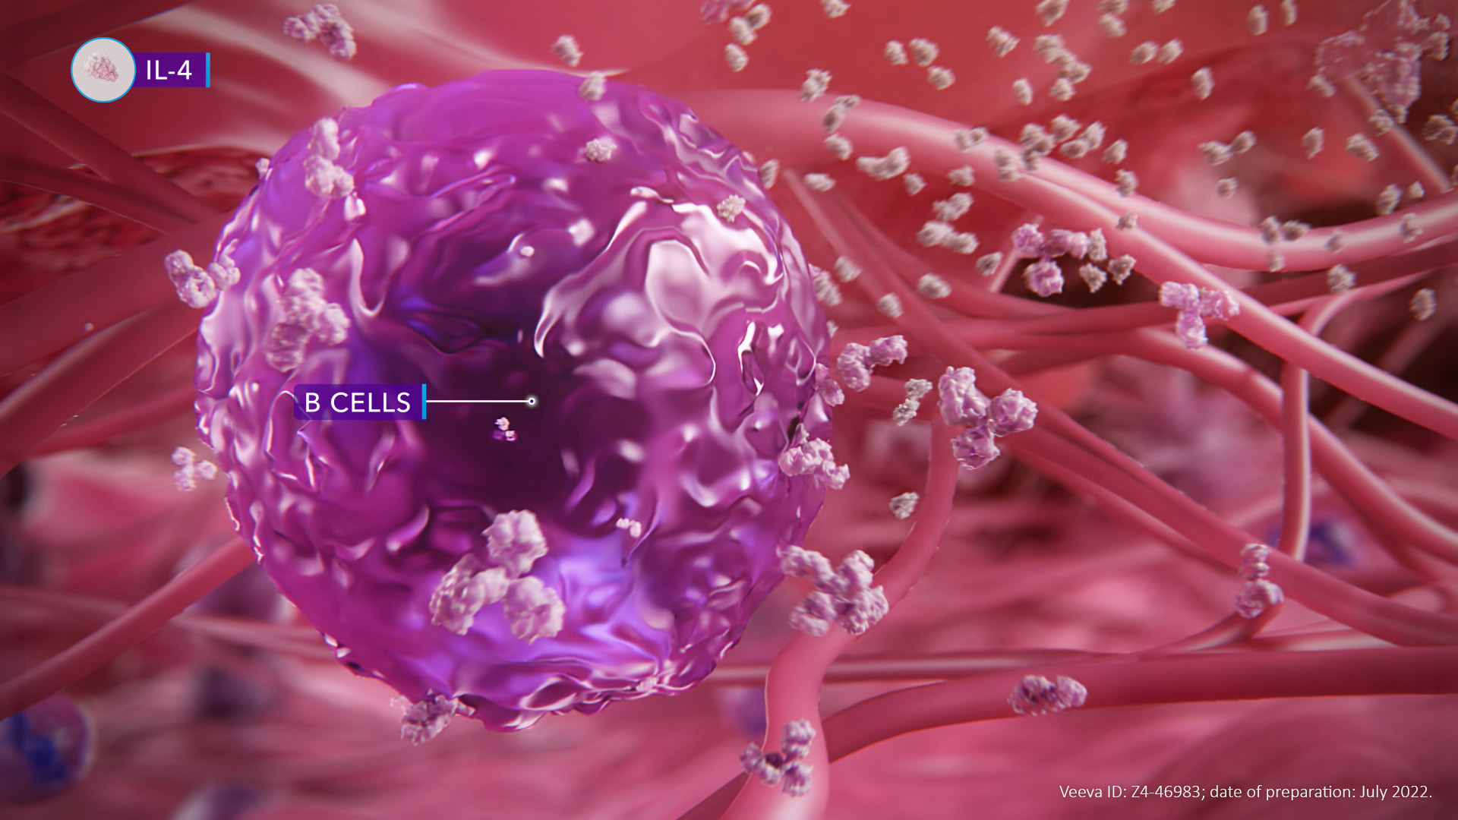
B-cell synthesis of IgE is upregulated in response to inflammatory signalling
IL-4, released by Th2 cells in response to stimulation by epithelial cytokines, triggers immunoglobulin class switching and the production of IgE by B cells^{1–3}
IgE, immunoglobulin E; IL, interleukin; Th, T helper
1. Menzies-Gow A, et al. Respir Res. 2020;21:268; 2. Roan F, et al. J Clin Invest. 2019;129:1441–1451; 3. Gauvreau GM, et al. Expert Opin Ther Targets. 2020;24:777–792

Slide 10
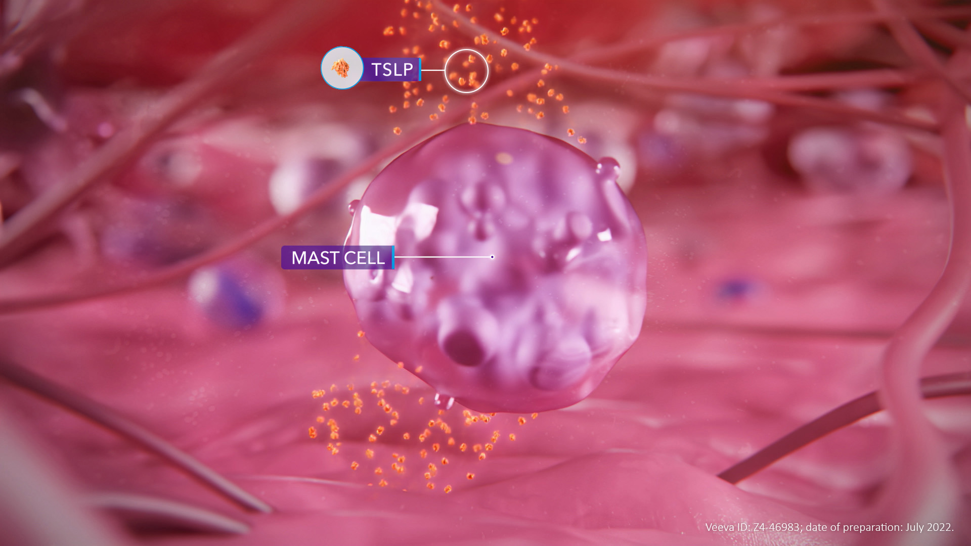
TSLP can influence mast cells, contributing to airway hyperresponsiveness
As part of its T2-independent effects, TSLP can regulate the crosstalk between mast cells and airway smooth muscle by stimulating the release of signalling molecules.¹ In doing so,
TSLP-mediated mast cell-airway smooth muscle crosstalk can contribute to airway hyperresponsiveness² – a cardinal feature of asthma³
T2, type 2; TSLP, thymic stromal lymphopoietin
1. Kaur D, et al. Chest. 2012;142:76–85; 2. Gauvreau GM, et al. Expert Opin Ther Targets. 2020;24:777–792; 3. Chapman DG, Irvin CG. Clin Exp Allergy. 2015;45:706–719

Slide 11
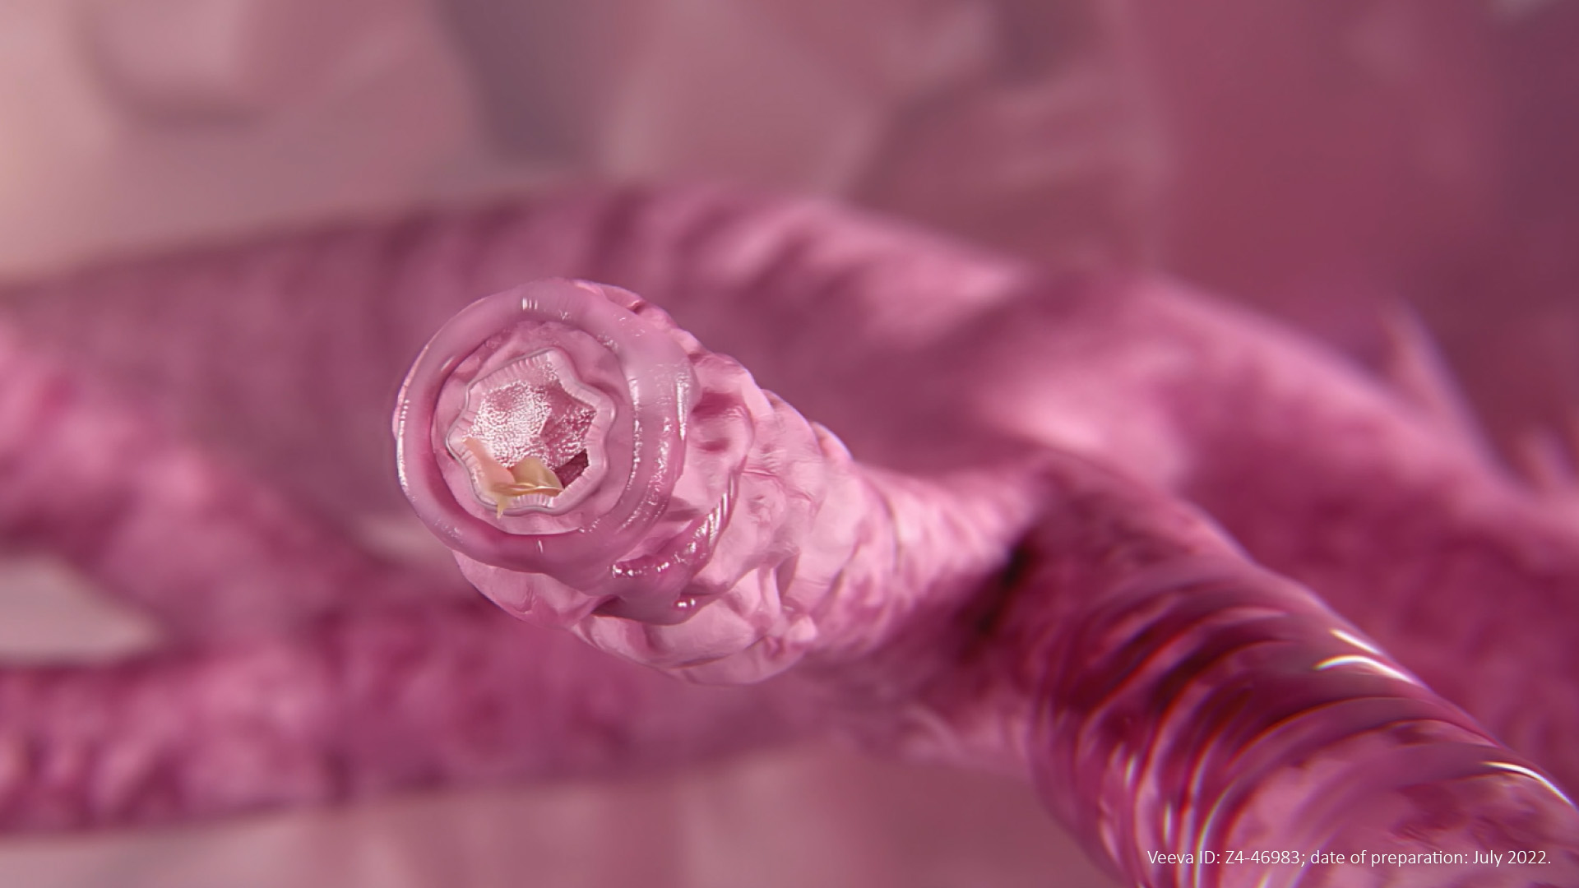
Epithelial cytokines drive pathophysiological changes to the airways in patients with asthma
As a result of inflammatory signalling downstream of the epithelial cytokines TSLP, IL-33 and IL-25, airway inflammation can ultimately lead to oedema, mucus hypersecretion, airway hyperresponsiveness and bronchoconstriction^{1–5}
IL, interleukin; TSLP, thymic stromal lymphopoietin
1. Bartemes KR, Kita H. Clin Immunol. 2012;143:222–235; 2. Marone G, et al. Front Pharmacol. 2019;10:1387; 3. Gauvreau GM, et al. Expert Opin Ther Targets. 2020;24:777–792;
4. Sumi Y, Hamid Q. Allergol Int. 2007;56:341–348; 5. Porsbjerg CM, et al. Eur Respir J. 2020;56:2000260

Slide 12
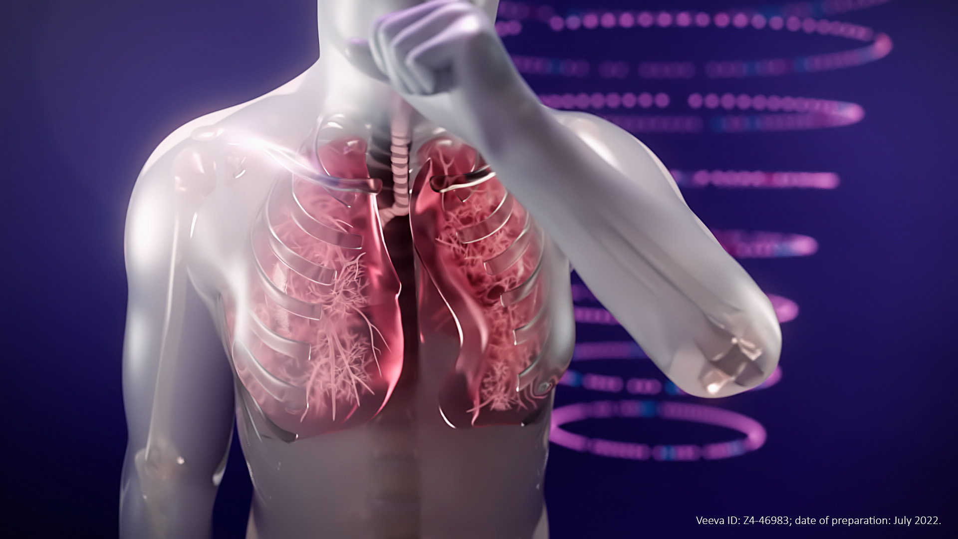
Clinical features of asthma are associated with the downstream effects of epithelial cytokines
Pathophysiological changes occurring in the airways, as a result of epithelial cytokine-mediated inflammatory signalling, can drive clinical features of asthma including cough, wheeze, shortness of breath and increased risk of severe asthma exacerbations^{1,2}
1. Porsbjerg CM, et al. Eur Respir J. 2020;56:2000260; 2. Heijink IH, et al. Allergy. 2020;75:1902–1917

